Slide 1
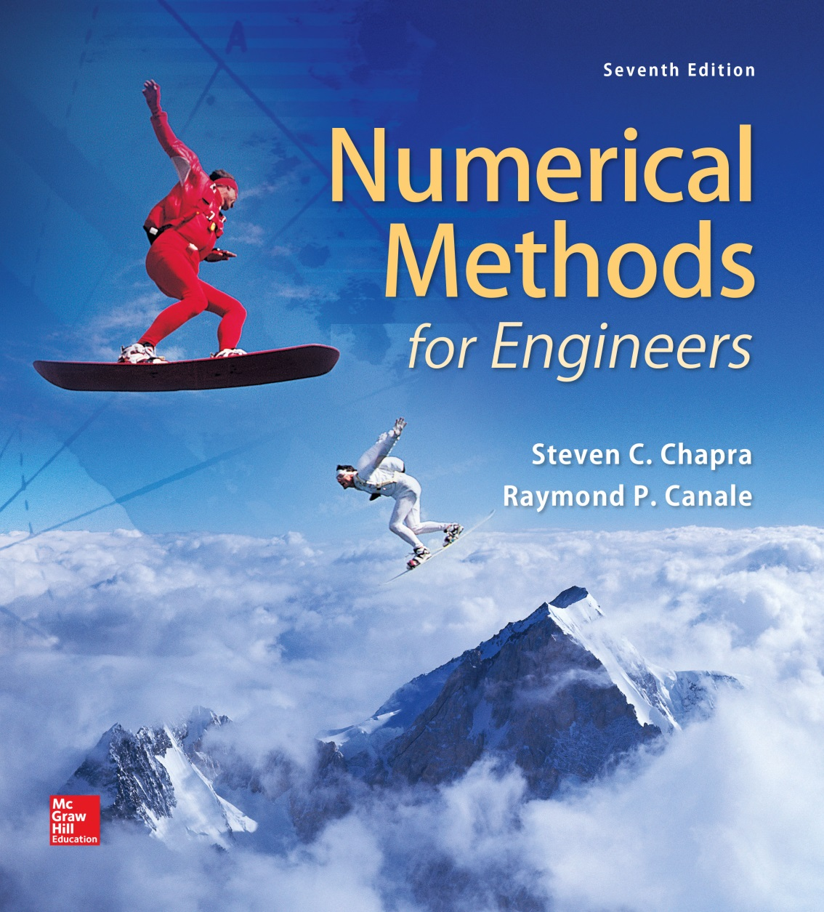
Chapter 14

Slide 2
Multidimensional Unconstrained Optimization
Chapter 14
Techniques to find minimum and maximum of a function of several variables are described.
These techniques are classified as:
  That require derivative evaluation
    Gradient or descent (or ascent) methods
  That do not require derivative evaluation
    Non-gradient or direct methods.

Slide 3
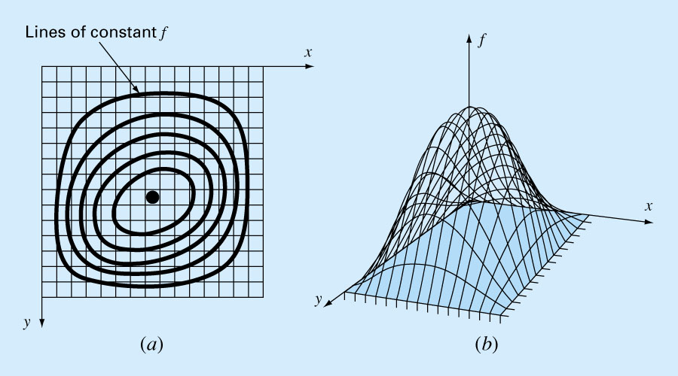
Figure 14.1

Slide 4
DIRECT METHODS
Random Search
Based on evaluation of the function randomly at selected values of the independent variables.
If a sufficient number of samples are conducted, the optimum will be eventually located.
Example: maximum of a function
f (x, y)=y-x-2x²-2xy-y²
can be found using a random number generator.

Slide 5
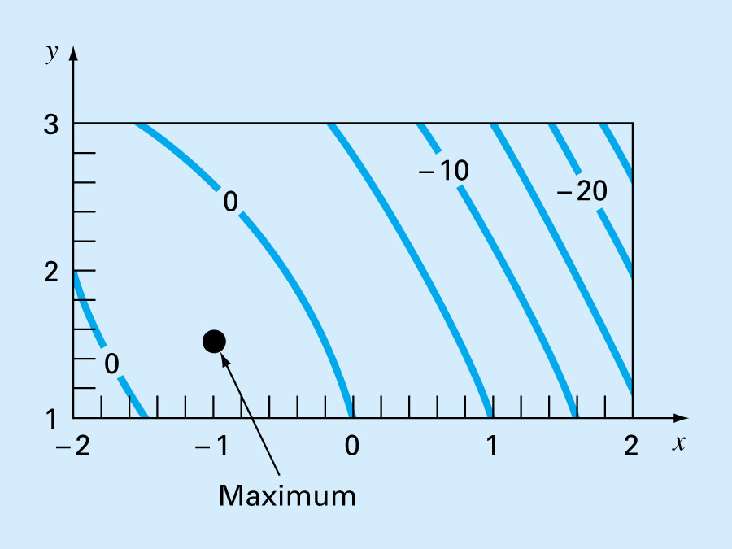
Figure 14.2

Slide 6
Advantages/
Works even for discontinuous and nondifferentiable functions.
Always finds the global optimum rather than the global minimum.
Disadvantages/
As the number of independent variables grows, the task can become onerous.
Not efficient, it does not account for the behavior of underlying function.

Slide 7
Univariate and Pattern Searches
More efficient than random search and still doesn’t require derivative evaluation.
The basic strategy is:
  Change one variable at a time while the other variables are held constant.
  Thus problem is reduced to a sequence of one-dimensional searches that can be solved by variety of methods.
  The search becomes less efficient as you approach the maximum.

Slide 8
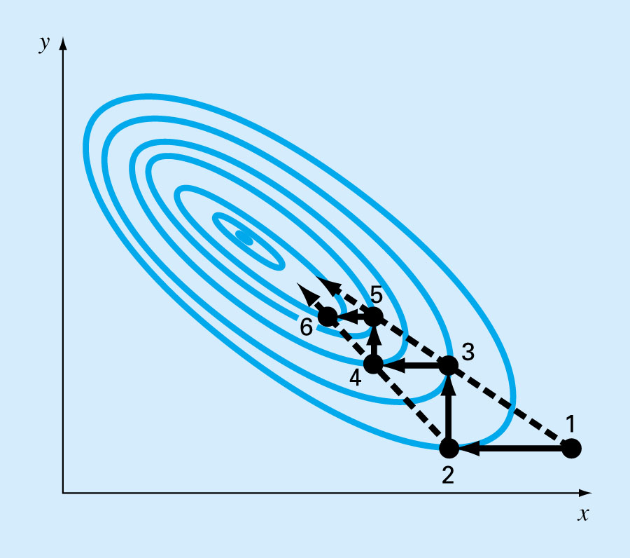
Figure 14.3

Slide 9
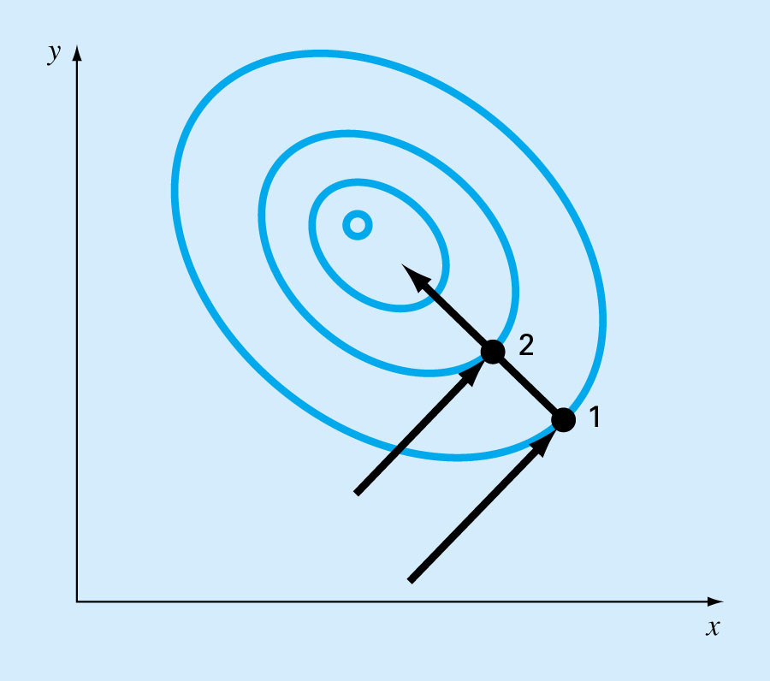
Pattern directions can be used to shoot directly along the ridge towards maximum.
Figure 14.4

Slide 10
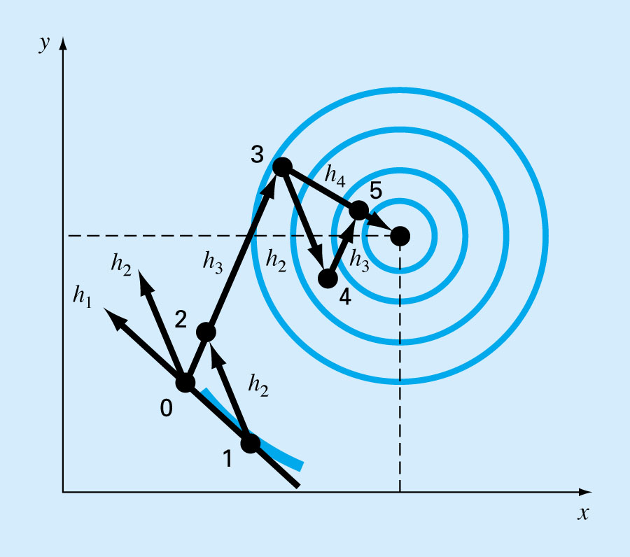
Figure 14.5
Best known algorithm, Powell’s method, is based on the observation that if points 1 and 2 are obtained by one-dimensional searches in the same direction but from different starting points, then, the line formed by 1 and 2 will be directed toward the maximum. Such lines are called conjugate directions.

Slide 11
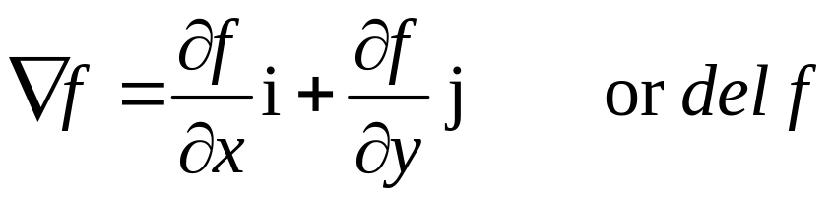
GRADIENT METHODS
Gradients and Hessians
The Gradient/
If f(x,y) is a two dimensional function, the gradient vector tells us
  What direction is the steepest ascend?
  How much we will gain by taking that step?
Directional derivative of f(x,y) at point x=a and y=b

Slide 12
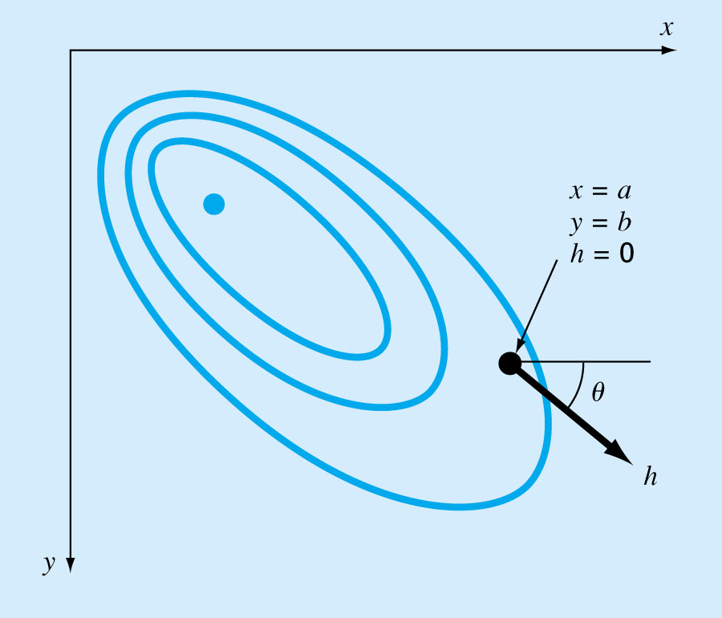
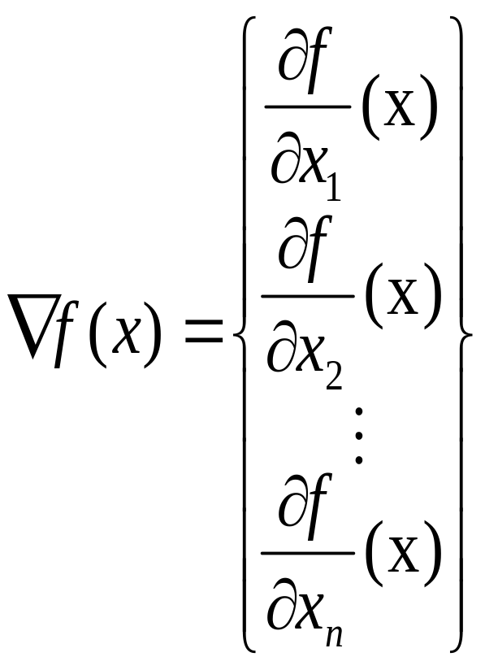
Figure 14.6
For n dimensions

Slide 13
The Hessian/
For one dimensional functions both first and second derivatives valuable information for searching out optima.
  First derivative provides (a) the steepest trajectory of the function and (b) tells us that we have reached the maximum.
  Second derivative tells us that whether we are a maximum or minimum.
For two dimensional functions whether a maximum or a minimum occurs involves not only the partial derivatives w.r.t. x and y but also the second partials w.r.t. x and y.

Slide 14
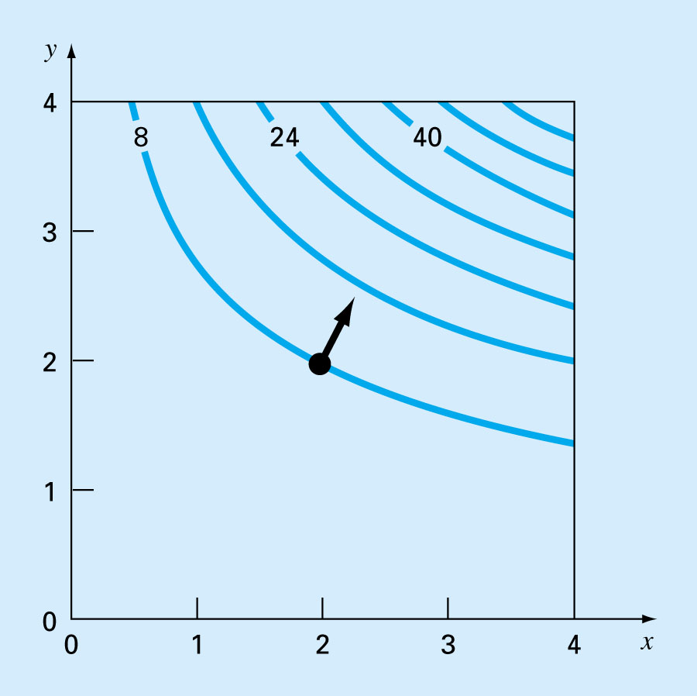
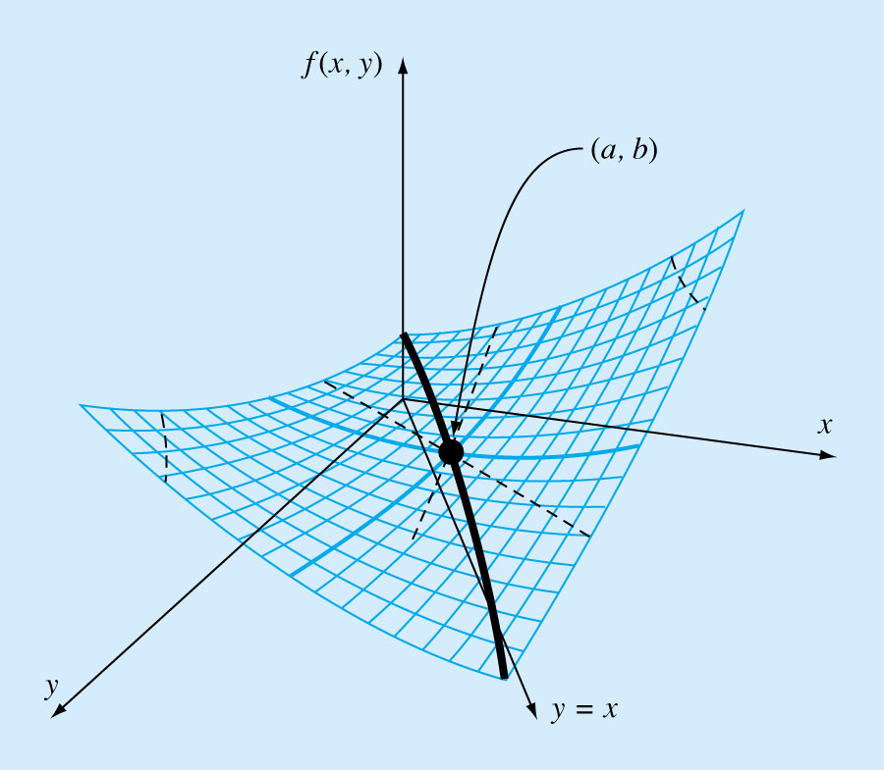
Figure 14.7
Figure 14.8

Slide 15
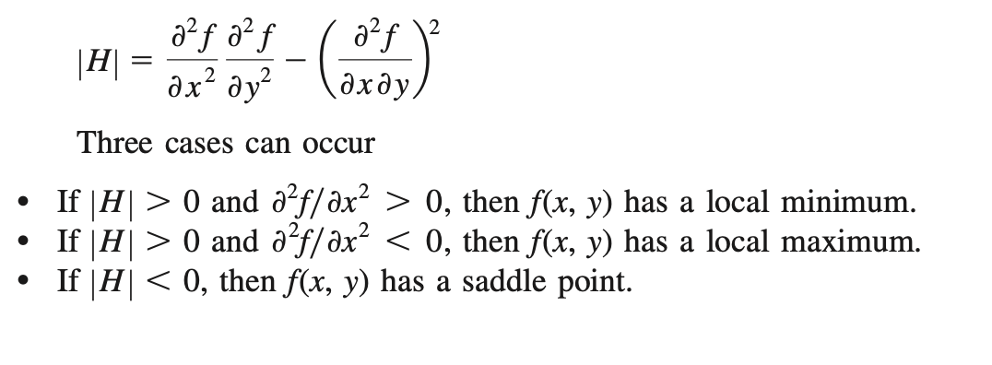
Assuming that the partial derivatives are continuous at and near the point being evaluated
The quantity [H] is equal to the determinant of a matrix made up of second derivatives

Slide 16
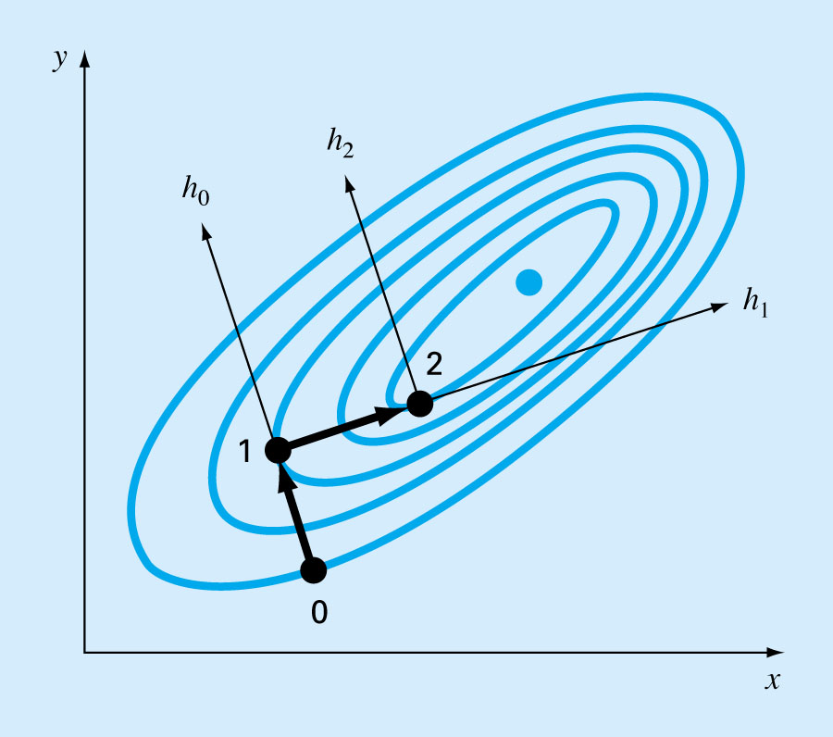
The Steepest Ascend Method
Figure 14.9
Start at an initial point (x_{o},y_{o}), determine the direction of steepest ascend, that is, the gradient. Then search along the direction of the gradient, h_{o}, until we find maximum. Process is then repeated.

Slide 17
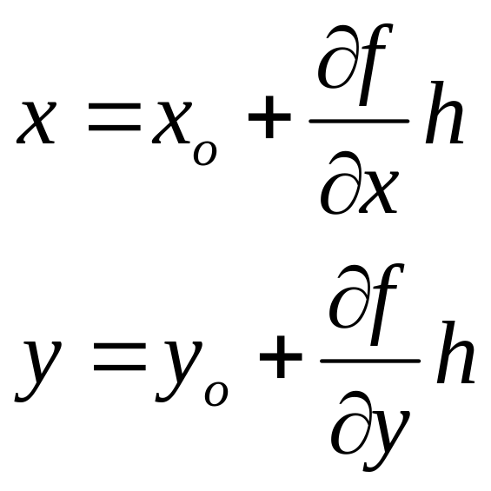
The problem has two parts
  Determining the “best direction” and
  Determining the “best value” along that search direction.
Steepest ascent method uses the gradient approach as its choice for the “best” direction.
To transform a function of x and y into a function of h along the gradient section:
h is distance along the h axis

Slide 18
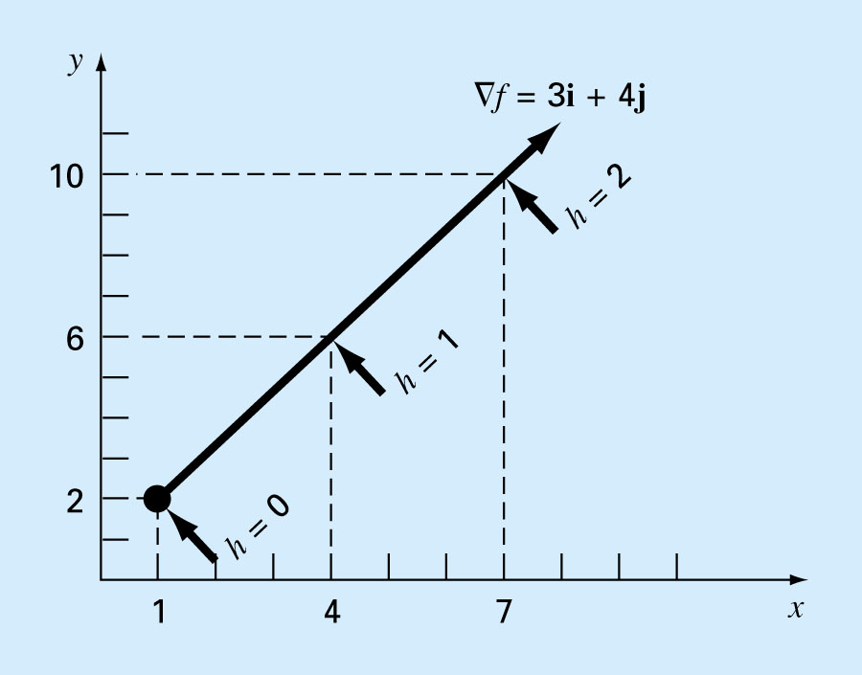
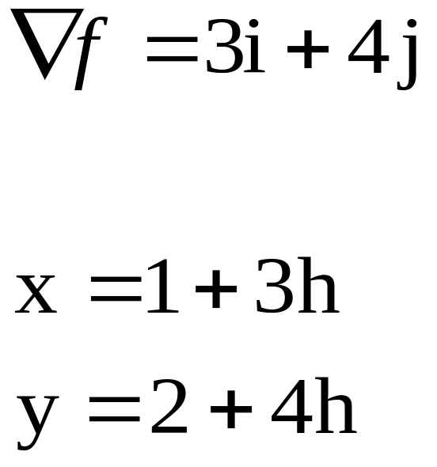
If x_{o}=1 and y_{o}=2
Figure 14.10

Slide 19
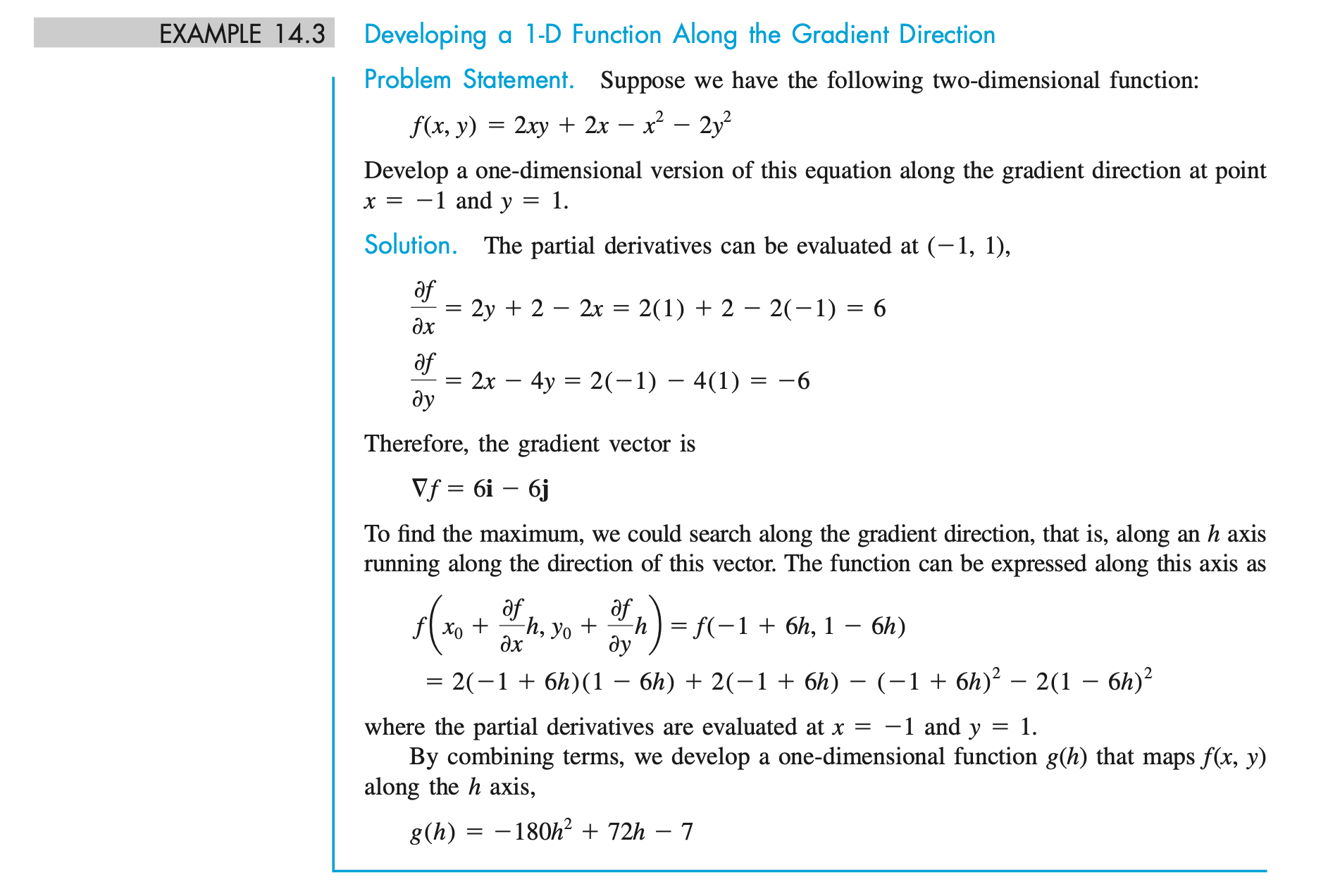

Slide 20
